Slide 1

A Presentation
on
MADHYANCHAL ELECTRICITY DISTRIBUTION CORPORATION LTD,
33/11kV SUBSTATION BAREL,
BARABANKI (UP)
Presented By :
Abhay Mishra &
Pranjal vishwakarma
Branch : Electrical Engineering 2nd Year
Government Polytechnic Jamuniya Deeh Harakh, Barabanki, (UP)
Submitted By :
Sakshi Ma’am
(Lecturer Electrical Engineering)
Notes:
Powered By : Aeronix Aavyuh

Slide 2

Overview
Transformer
Current Transformer
Potential Transformer
Bus Coupler
Circuit Breaker
Lighting Arrester
Bus Bar
Switch Gear
Isolator
Battery Room
Fire Extinguisher
Control Room
Certificate

Slide 3
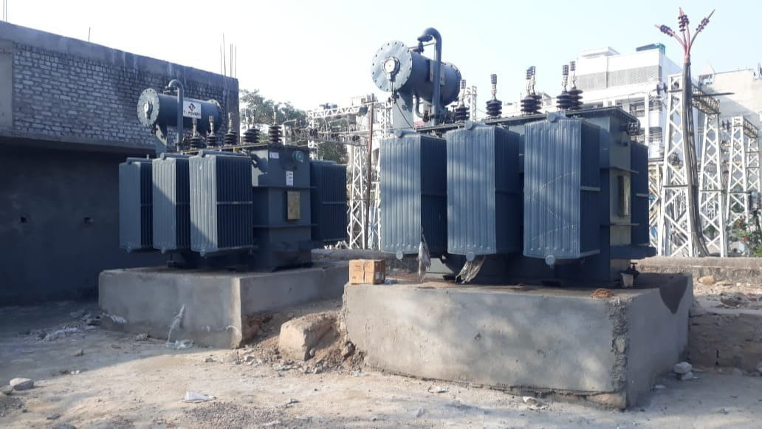
Transformer (8MVA)
BHEL, Bharat Heavy Electrical Ltd.
Telangana (Hyderabad)

Slide 4
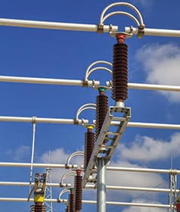
Bus Coupler
To connect two busbars and allow power transfer between them.
To isolate or sectionalize parts of the system for maintenance or fault.

Slide 5
Bus Coupler
To connect two busbars and allow power transfer between them.
To isolate or sectionalize parts of the system for maintenance or fault.

Slide 6
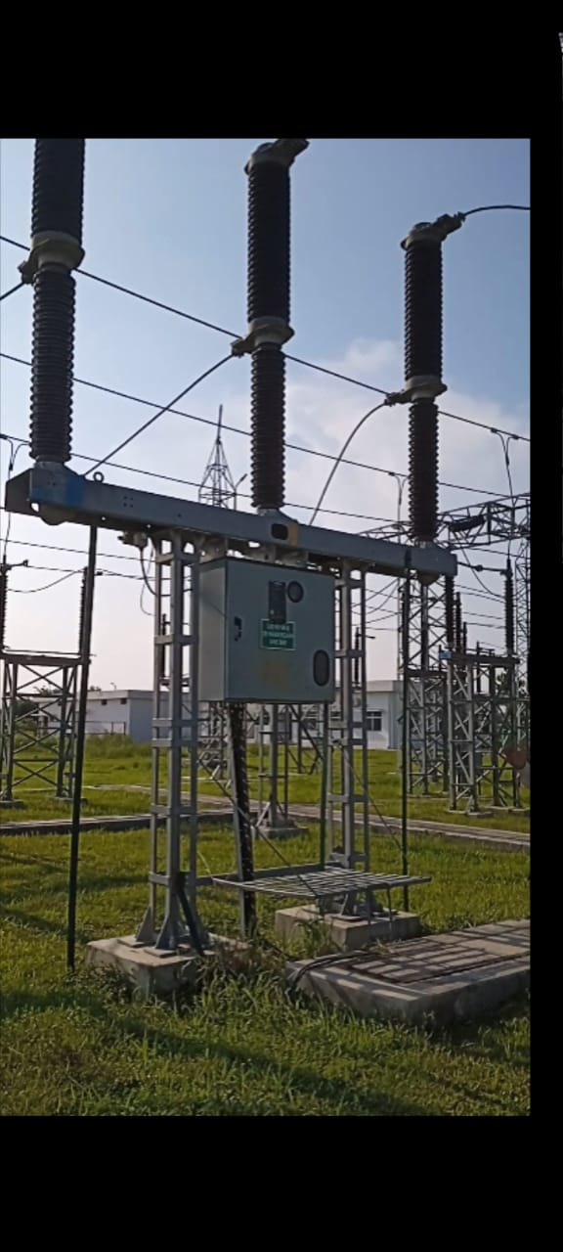
Circuit Breaker
To automatically interrupt the flow of electric current in case of overload or fault.
To protect electrical equipment and ensure safety of the power system.

Slide 7
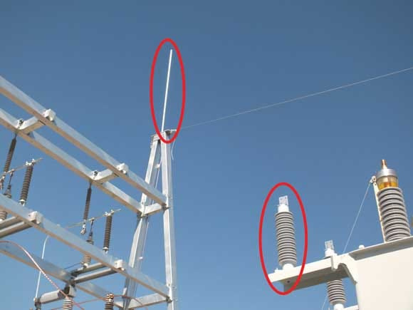
Lighting Arrester
To protect electrical equipment from high-voltage lightning strikes.
To safely divert the lightning current to the ground.

Slide 8
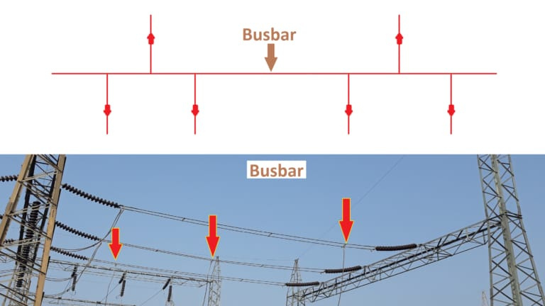
Bus Bar
To carry and distribute electrical power efficiently.
To connect multiple circuits within a switchgear or
substation.

Slide 9
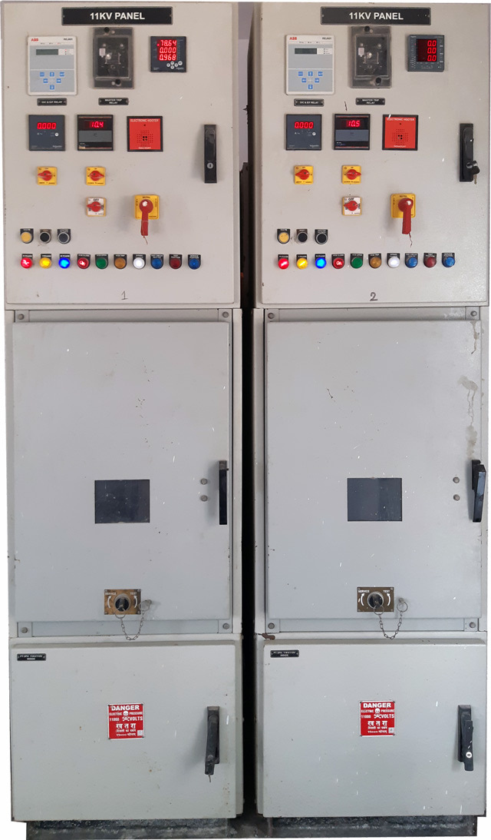
Switch Gear
To control, protect, and isolate electrical equipment in a power system.
To ensure safe and reliable operation of the electrical network.

Slide 10
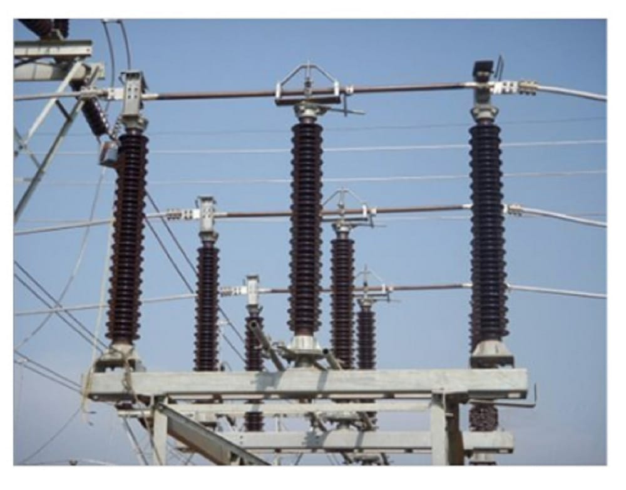
Isolator
To disconnect a part of the electrical circuit for maintenance or safety.
To ensure that the section is completely de-energized before work.

Slide 11
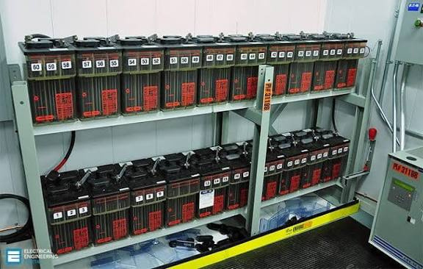
Battery Room
To safely store and house batteries used for backup power supply.
To provide continuous power during outages or emergency situations.

Slide 12
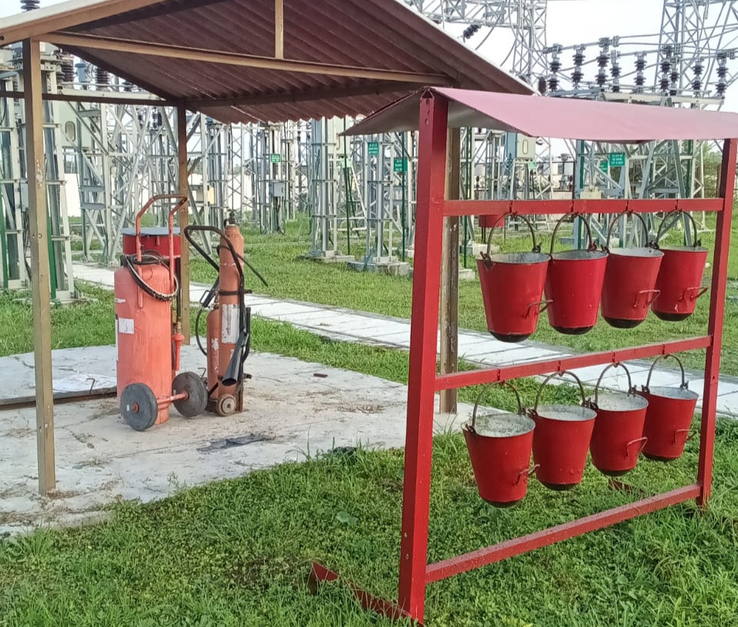
Fire Extinguisher

Slide 13
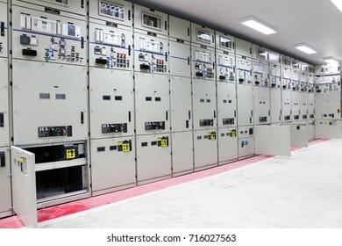
Control Room
To monitor and control the operation of electrical or industrial systems.
To ensure safe, efficient, and continuous functioning of the plant or network.

Slide 14
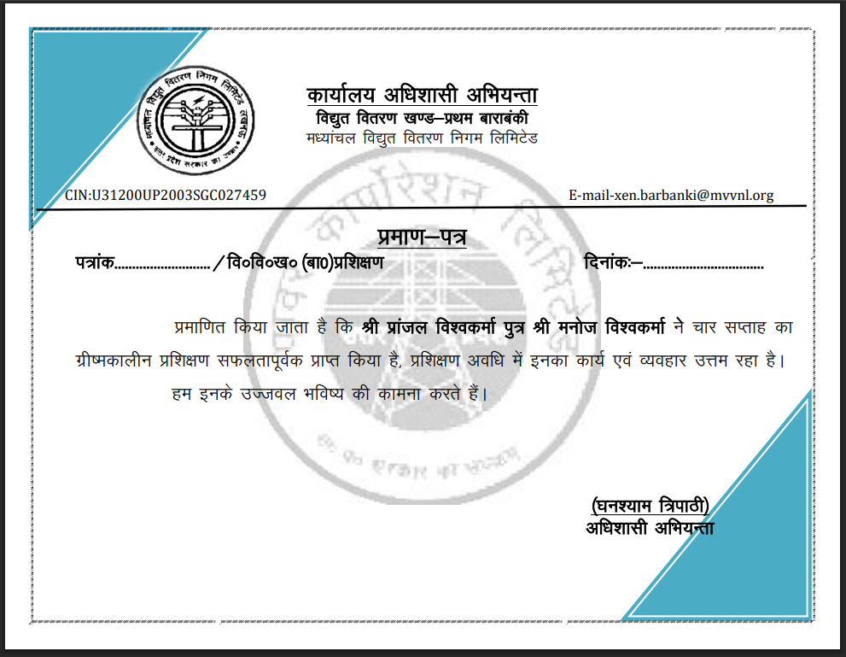
Certificate

Slide 15
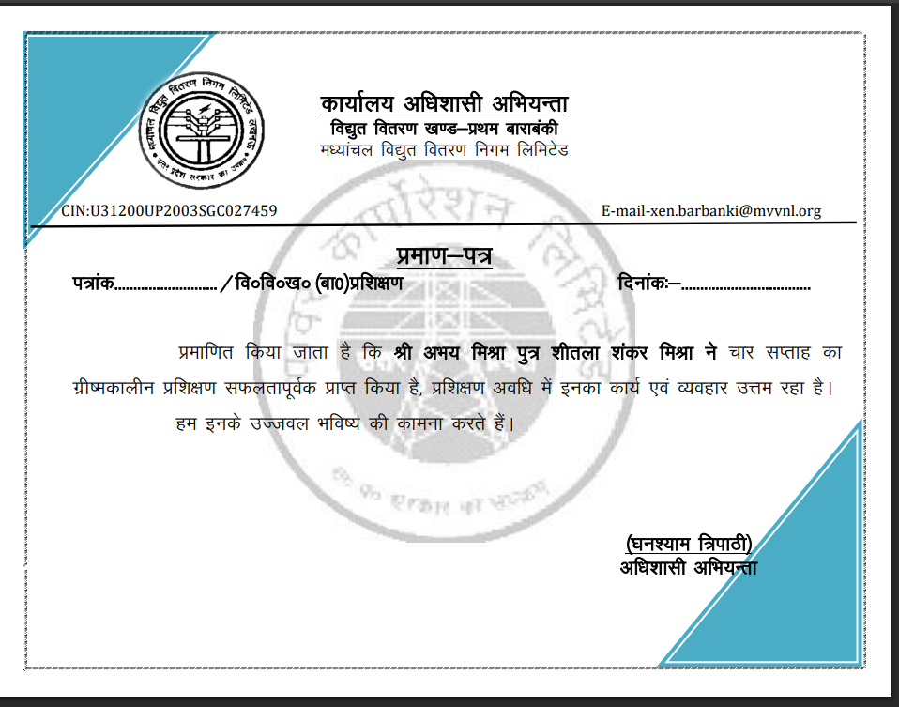
Certificate

Slide 16
THANK YOU!

